Slide 1


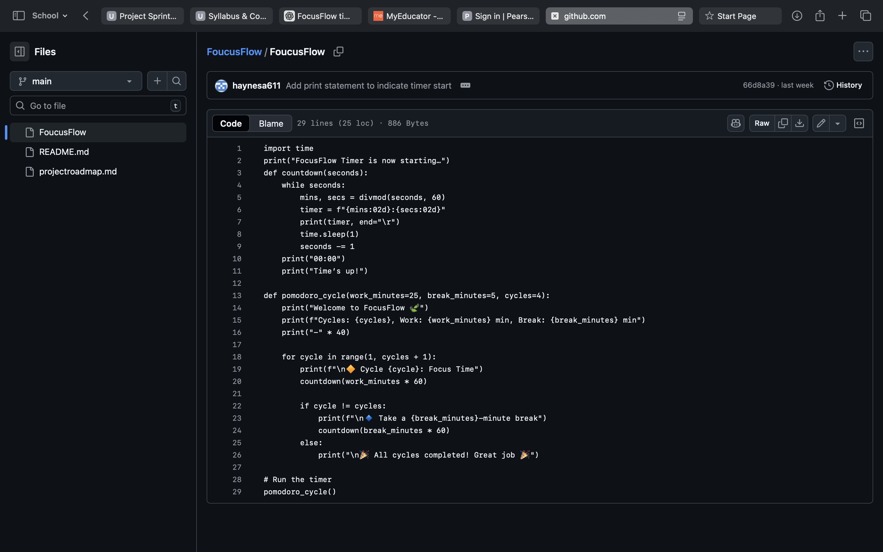
Focus Flow
Team Members: Ashley Haynes
A simple timer designed to help students stay focused.

